Slide 1
EXPLORING BLENDED LEARNING
A CASE STUDY OF ADULT LEARNERS USING A
LEARNING MANAGEMENT SYSTEM IN FACE-TO-FACE CLASSES
DR. JONATHAN DOWNS, ED.D., M.A.
DOCTORAL DISSERTATION DEFENSE
NORTHCENTRAL UNIVERSITY
DR. JUDITH CONVERSO, CHAIR
DR. JAMA BRADLEY, SME
DR. JEROME FORE, MCM
All rights reserved. Dr. Jonathan Downs, Ed.D., M.A.

Slide 2
HISTORY & BACKGROUND
From 2000-2012, adults returned en masse to U.S. colleges (NCES, 2014).
Adult learners comprise at much as 73% of total student enrollment (Choy, 2012).
Adult enrollment may continue to grow another 20% by 2019 (Bell, 2011).
Figure 1. Adult Learners in Academia
Clip Art Retrieved from: http://www.evolllution.com
EXPLORING BLENDED LEARNING
All rights reserved. Dr. Jonathan Downs, Ed.D., M.A.

Slide 3
HISTORY & BACKGROUND
Technological advancement has dramatically changed how colleges function (Dahlstrom & Bichsel, 2014).
Adult learners expect technology to be part of their learning experience (Burrell, 2011).
Students and instructors have different perceptions of how technology should be used (Hammer et al., 2010).
Figure 2. Technology Changes and User Perceptions
Clip Art Retrieved from: http://www.robertwmills.com
EXPLORING BLENDED LEARNING
All rights reserved. Dr. Jonathan Downs, Ed.D., M.A.

Slide 4
STATEMENT OF THE PROBLEM
The problem was that although college enrollments have increased due to the growing non-traditional student demographic, research results suggest that college leaders did not have a comprehensive strategy for effectively incorporating learning management systems in non-traditional, degree-completion programs (Messemer & Hansman, 2012; Burrell, Finch, Fisher, Rahim, & Dawson, 2011; Weimer, 2013).
Figure 3. Strategy
Clip Art Retrieved from: http://www.shutterstock.com
EXPLORING BLENDED LEARNING
All rights reserved. Dr. Jonathan Downs, Ed.D., M.A.

Slide 5
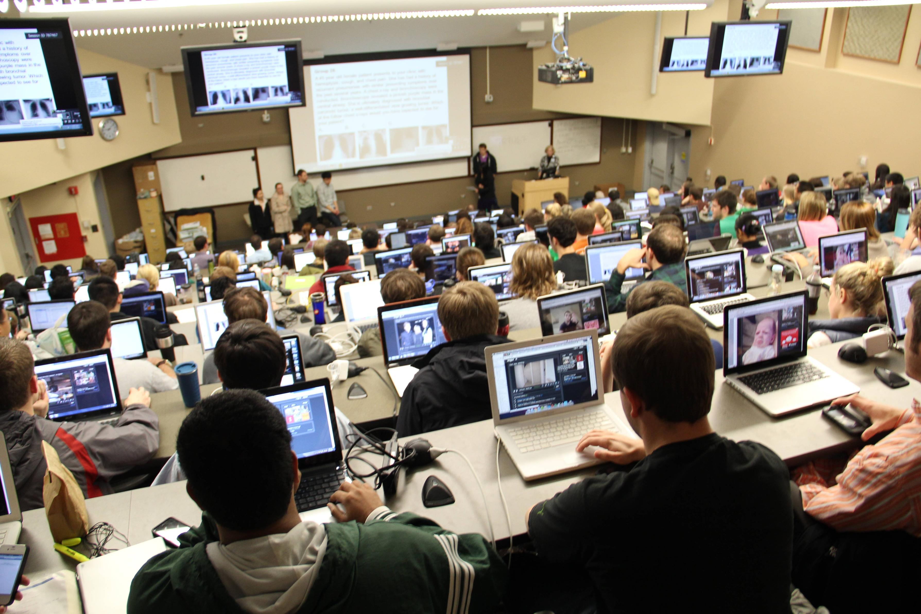
PURPOSE OF THE STUDY
The purpose of this qualitative, multiple case study was to gain insight and understanding on how a learning management system (LMS), such as Moodle, was used by students and instructors in a non-traditional, degree-completion program at a private, four-year college.
Figure 4. Classroom Technology
Clip Art Retrieved from: http://www.interchangeproject.org
EXPLORING BLENDED LEARNING
All rights reserved. Dr. Jonathan Downs, Ed.D., M.A.

Slide 6
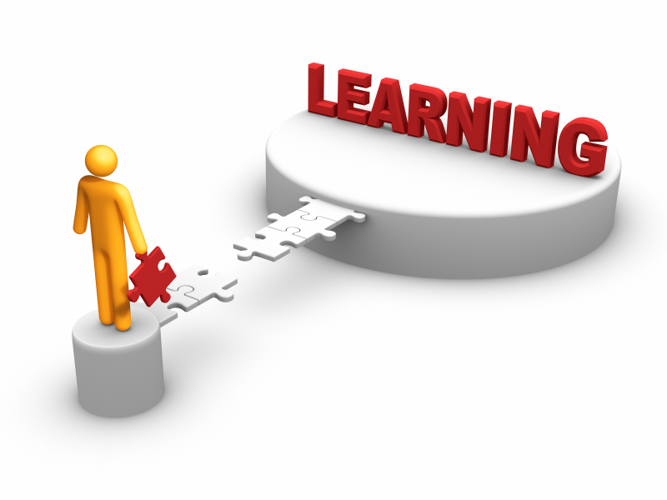
PHENOMENON
The phenomenon that was studied was how an LMS was used to facilitate the learning process and achieve learning outcomes for adult learners in a non-traditional, degree-completion program.
Figure 5. Learning
Clip Art Retrieved from: http://www.a2ua.com
EXPLORING BLENDED LEARNING
All rights reserved. Dr. Jonathan Downs, Ed.D., M.A.

Slide 7
RESEARCH QUESTION ONE
As perceived by instructors and students, how does a learning management system (LMS), such as Moodle, influence non-traditional students’ learning outcomes managed in a blended learning setting in the Applied Organizational leadership (AOL) degree completion program at Midwest University (MWU)?
RQ1.
EXPLORING BLENDED LEARNING
All rights reserved. Dr. Jonathan Downs, Ed.D., M.A.

Slide 8
RESEARCH QUESTION TWO
As perceived by instructors and students, how can a learning management system (LMS), such as Moodle, improve non-traditional students’ learning in the Applied Organizational Leadership (AOL) degree-completion program at Midwest University (MWU)?
RQ2.
EXPLORING BLENDED LEARNING
All rights reserved. Dr. Jonathan Downs, Ed.D., M.A.

Slide 9
THE STUDY
20 interviews conducted
10 students
10 instructors
Instructor-provided syllabi reviewed
Instructor-provided grading rubrics reviewed
Figure 6. Study Data Sources
Clip Art Retrieved from: http://blog.carlynworks.com
EXPLORING BLENDED LEARNING
All rights reserved. Dr. Jonathan Downs, Ed.D., M.A.

Slide 10
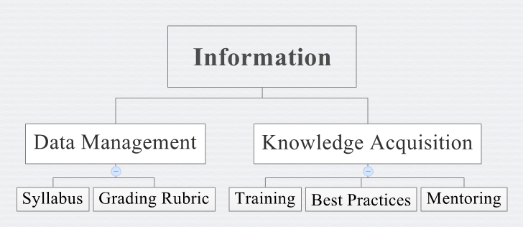
RESULTS
Figure 7. Results: Information. Emergent Themes Related to Research Question One: How does a learning management system (LMS), such as Moodle, influence non-traditional students’ learning outcomes managed in a blended learning setting in the Applied Organizational leadership (AOL) degree completion program at Midwest University (MWU) as perceived by students and instructors?
EXPLORING BLENDED LEARNING
All rights reserved. Dr. Jonathan Downs, Ed.D., M.A.

Slide 11
FINDINGS
Incorporating a Standardized Syllabus
Include all activities and assignments
Tie to learning outcomes
Incorporating a Standardized Grading Rubric
Include all activities and assignments
Ensure rubric is consistent with LMS gradebook
CREATING A DATA MANAGEMENT SYSTEM
EXPLORING BLENDED LEARNING
All rights reserved. Dr. Jonathan Downs, Ed.D., M.A.

Slide 12
FINDINGS
PROVIDING PROFESSIONAL DEVELOPMENT FOCUSED ON KNOWLEDGE ACQUISITION
Providing Training
Implementing Best Practices
Supporting Instructors through Mentoring
EXPLORING BLENDED LEARNING
All rights reserved. Dr. Jonathan Downs, Ed.D., M.A.

Slide 13
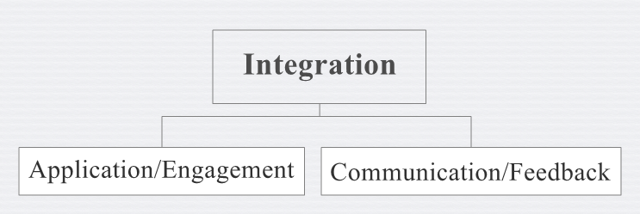
RESULTS
Figure 8. Results: Integration. Emergent Themes Related to Research Question Two: How can a learning management system (LMS), such as Moodle, improve non-traditional students’ learning in the Applied Organizational Leadership (AOL) degree-completion program at Midwest University, as perceived by students and instructors?
EXPLORING BLENDED LEARNING
All rights reserved. Dr. Jonathan Downs, Ed.D., M.A.

Slide 14
FINDINGS
Ginsburg’s (2015) “3 C’s”
Reducing Confusion
Improving Clarity
Offering Continuity of Information
IMPROVING STUDENT ENGAGEMENT
EXPLORING BLENDED LEARNING
All rights reserved. Dr. Jonathan Downs, Ed.D., M.A.

Slide 15
FINDINGS
Maintaining Student Contact Between Face-to-Face (F2F) Classes
One instructor remarked: I believe it’s giving them that opportunity to have [a] voice when sometimes in the face-to-face class, they can’t speak quick[ly] enough (Participant 4).
Evaluating LMS Usage to Prepare For vs. Reinforcing F2F Classes
FACILITATING INSTRUCTOR FEEDBACK
EXPLORING BLENDED LEARNING
All rights reserved. Dr. Jonathan Downs, Ed.D., M.A.

Slide 16
LIMITATIONS
Transferability of theories
One program, one university
Sample size
Participants (only students and instructors)
Two data documents
Figure 9. Limitations
Clip Art Retrieved from: http://blog.sqlauthority.com
EXPLORING BLENDED LEARNING
All rights reserved. Dr. Jonathan Downs, Ed.D., M.A.

Slide 17
IMPLICATIONS
Need to standardize syllabi and grading rubrics
Ensure activities and assignments are included and connected to learning outcomes
Need to develop and provide a comprehensive training program
Empower students and instructors to effectively use an LMS
RQ1.
EXPLORING BLENDED LEARNING
All rights reserved. Dr. Jonathan Downs, Ed.D., M.A.

Slide 18
IMPLICATIONS
Need to train and mentor instructors on essential skills and best practices
Increase student engagement when using an LMS
Need for instructors to increase communication with students between F2F classes
Answer questions, provide clarification, provide feedback, update grades
RQ2.
EXPLORING BLENDED LEARNING
All rights reserved. Dr. Jonathan Downs, Ed.D., M.A.

Slide 19
RECOMMENDATIONS
FOR FURTHER RESEARCH
1. Conduct a similar study on a larger scale.
Include more students and instructors
Include college administrators, instructional designers, information specialists
Include graduate students
Figure 10. Recommendation: Expand the Scope of the Study
Clip Art Retrieved from: http://2012onwards.com
EXPLORING BLENDED LEARNING
All rights reserved. Dr. Jonathan Downs, Ed.D., M.A.

Slide 20
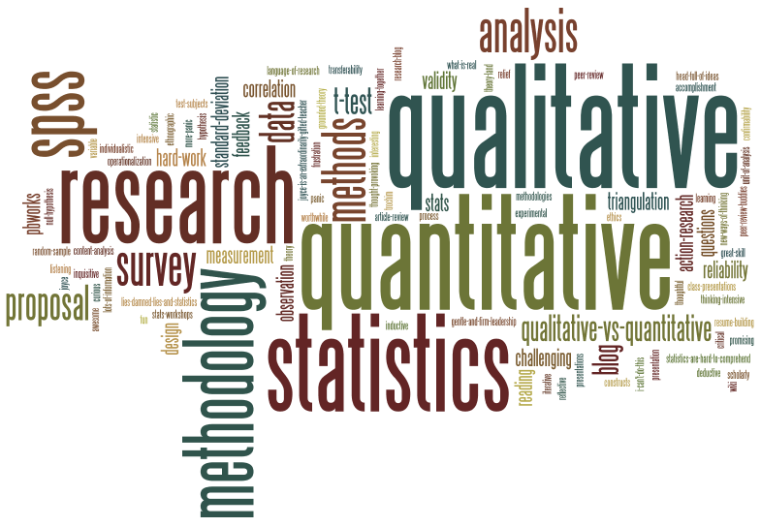
RECOMMENDATIONS
FOR FURTHER RESEARCH
2. Design a similar study using a quantitative or mixed-methods approach.
Use Likert-scale or scoring-based data collection instrument
Reduce open-ended responses
Increase statistical data
Figure 11. Recommendation: Alternative Research Methods/Designs
Clip Art Retrieved from: http://myscholarzone.com
EXPLORING BLENDED LEARNING
All rights reserved. Dr. Jonathan Downs, Ed.D., M.A.

Slide 21
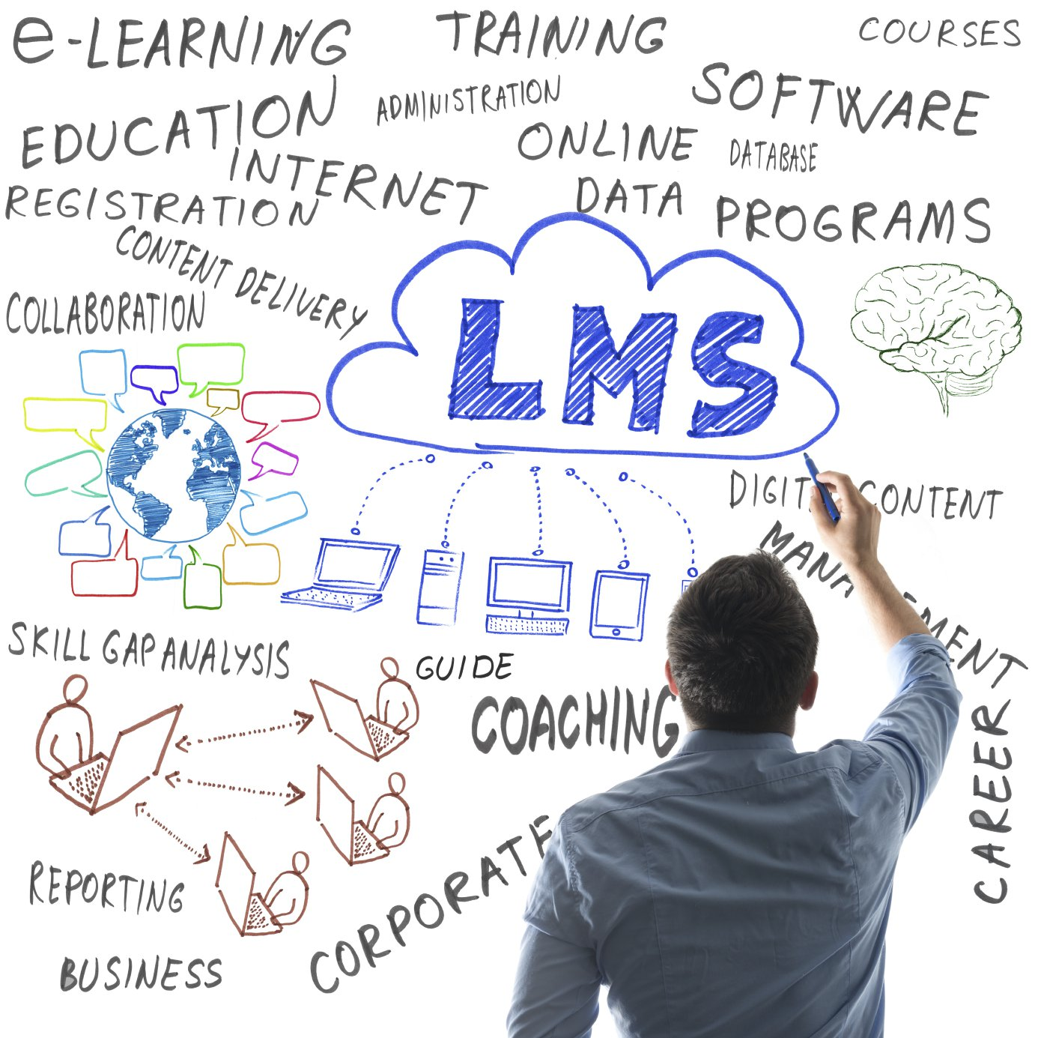
RECOMMENDATIONS
FOR FURTHER RESEARCH
3. Evaluate different learning management systems.
Consider ANGEL, BlackBoard, Canvas, Desire2Learn, WebCT
Consider cloud-based, historical, open-source, and proprietary
(Dias & Diniz, 2014; Gary, 2013; Yong & Mills, 2014)
Figure 12. Recommendation: Evaluation of Different LMS’s
Clip Art Retrieved from: http://360training.com
EXPLORING BLENDED LEARNING
All rights reserved. Dr. Jonathan Downs, Ed.D., M.A.

Slide 22
RECOMMENDATIONS
FOR FURTHER RESEARCH
4. Broaden the scope of the population and research setting.
Consider different subject disciplines including Education, Nursing, and Psychology
Consider different colleges
Consider different degree-completion programs based on format, pace, and structure
Figure 13. Recommendation: Broaden Scope of Study within College Settings
Clip Art Retrieved from: http://wikipedia/cambridge.com
EXPLORING BLENDED LEARNING
All rights reserved. Dr. Jonathan Downs, Ed.D., M.A.

Slide 23
RECOMMENDATIONS
FOR FURTHER RESEARCH
5. Research different educational technologies.
Consider MOOC’s, interactive media, presentation media, social media
Re-evaluate how various educational technologies impact program-specific learning outcomes
(Rosen, 2013; Snyder, 2015; Wang, Lit woo, Lang Quek, Yang, and Liu, 2012)
Figure 14. Recommendation: Research Different Educational Technologies
Clip Art Retrieved from: http://diygenius.com
EXPLORING BLENDED LEARNING
All rights reserved. Dr. Jonathan Downs, Ed.D., M.A.

Slide 24
RECOMMENDATIONS
FOR PRACTICAL APPLICATION
1. Implement a comprehensive LMS training program.
For new instructors, include basic orientation to intermediate skills
For established instructors, evaluate best practices, new resources, and education on upgraded software versions
Provide face-to-face, hands-on learning format
Figure 15. Recommendation: Comprehensive Instructor Training
Clip Art Retrieved from: http://astm.org
EXPLORING BLENDED LEARNING
All rights reserved. Dr. Jonathan Downs, Ed.D., M.A.

Slide 25
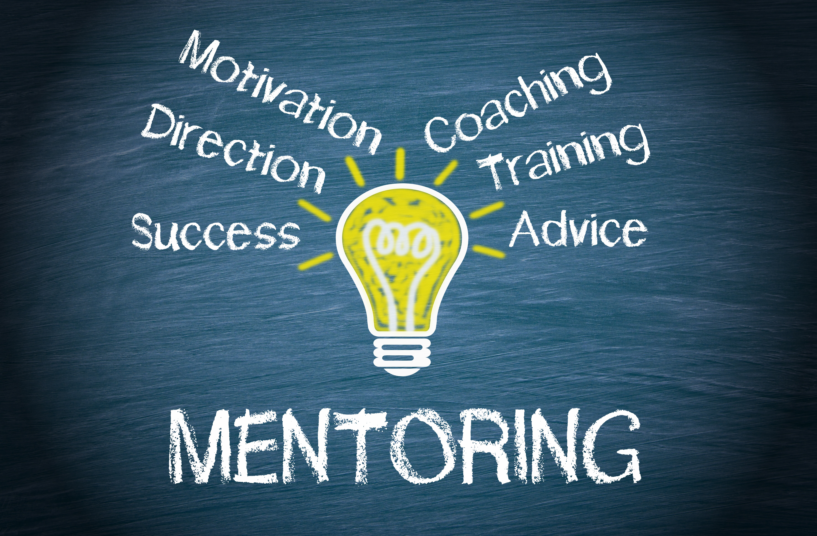
RECOMMENDATIONS
FOR PRACTICAL APPLICATION
2. Manage mentoring program for instructors.
Pair established instructors with new instructors
Meet no more frequently than semi-annually for face-to-face college-required training
Meet at least every other quarter for remote or online training
Figure 16. Recommendation: Mentoring Programs
Clip Art Retrieved from: http://afrocache.com
EXPLORING BLENDED LEARNING
All rights reserved. Dr. Jonathan Downs, Ed.D., M.A.

Slide 26
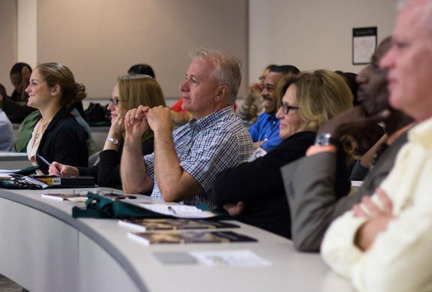
RECOMMENDATIONS
FOR PRACTICAL APPLICATION
3. Develop a focused LMS training program for students.
For traditional students, could be incorporated into first-year student program
For non-traditional students, could be part of orientation or convocation program
Adult learners prefer no more than two contact hours of training
Figure 17. Recommendation: Focused Student Training
Clip Art Retrieved from: http://www.stevenson.edu
EXPLORING BLENDED LEARNING
All rights reserved. Dr. Jonathan Downs, Ed.D., M.A.

Slide 27
RECOMMENDATIONS
FOR PRACTICAL APPLICATION
4. Create and coordinate standardized syllabi and grading rubrics for instructors.
Establish consistent format, structure, verbiage, as well as precision and scope of information for syllabi
Develop detailed data and consistent point system for grading rubrics
Figure 18. Recommendation: Standardized Syllabi
Clip Art Retrieved from: http://www.wordpress.com
EXPLORING BLENDED LEARNING
All rights reserved. Dr. Jonathan Downs, Ed.D., M.A.

Slide 28
RECOMMENDATIONS
FOR PRACTICAL APPLICATION
5. Establish adequate quality assurance measures for students and instructors.
Implement student progress reporting system to manage attendance, grades, technology, persistence, and graduation issues
Integrate policies and procedures for chairs and supervisors
Figure 19. Recommendation: Quality Assurance Measures
Clip Art Retrieved from: http://www.linkedin.com
EXPLORING BLENDED LEARNING
All rights reserved. Dr. Jonathan Downs, Ed.D., M.A.

Slide 29
EPILOGUE
Education has changed markedly over the past 20 years through a sharp influx of adult learners and increased technologies. Although adult learners appear poised to retain a prominent place on college campuses for many years, technology will likely forever be a part of education (NCES, 2014).
Colleges must ensure they develop a comprehensive strategy for assessing, implementing, and evaluating technological resources to help students succeed academically and instructors flourish professionally as college trends continue to change.
EXPLORING BLENDED LEARNING
All rights reserved. Dr. Jonathan Downs, Ed.D., M.A.

Slide 30
THANK YOU!!!
QUESTIONS AND ANSWERS
EXPLORING BLENDED LEARNING
All rights reserved. Dr. Jonathan Downs, Ed.D., M.A.

